Slide 1

Machine Learning
EEL4930 Machine Learning
Spring 2020

Slide 2
Instructors
Instructor: Dr. Catia S. Silva
Lecturer
Electrical & Computer Engineering
Office: NEB 467
Office Hours: Tuesdays 10:40 AM – 11:40 AM
Supervised Teacher: Matthew Cook
Ph.D. student
Machine Learning & Sensing Lab
Electrical & Computer Engineering
Office: NEB 401
Office Hours: TBD

Slide 3

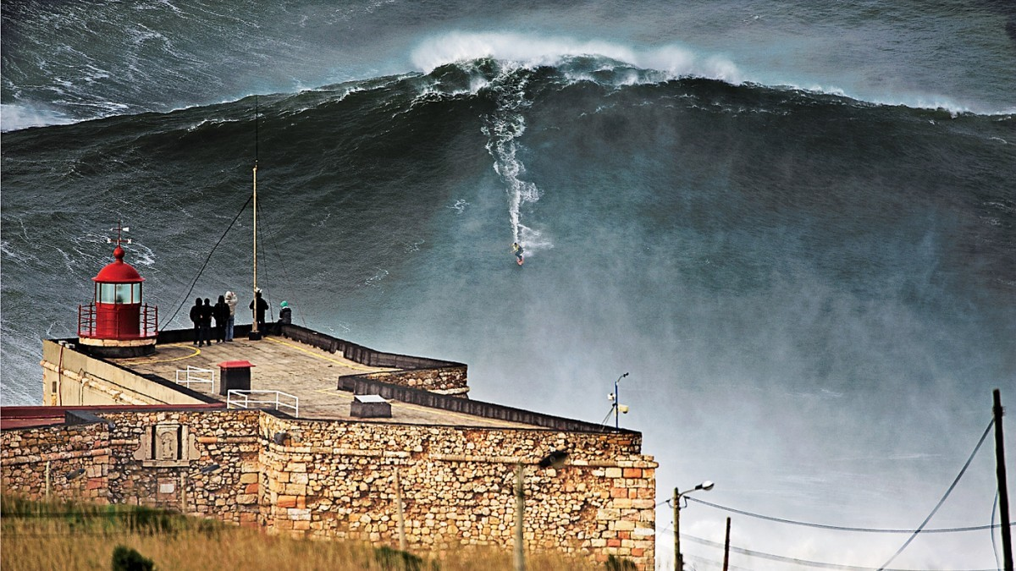


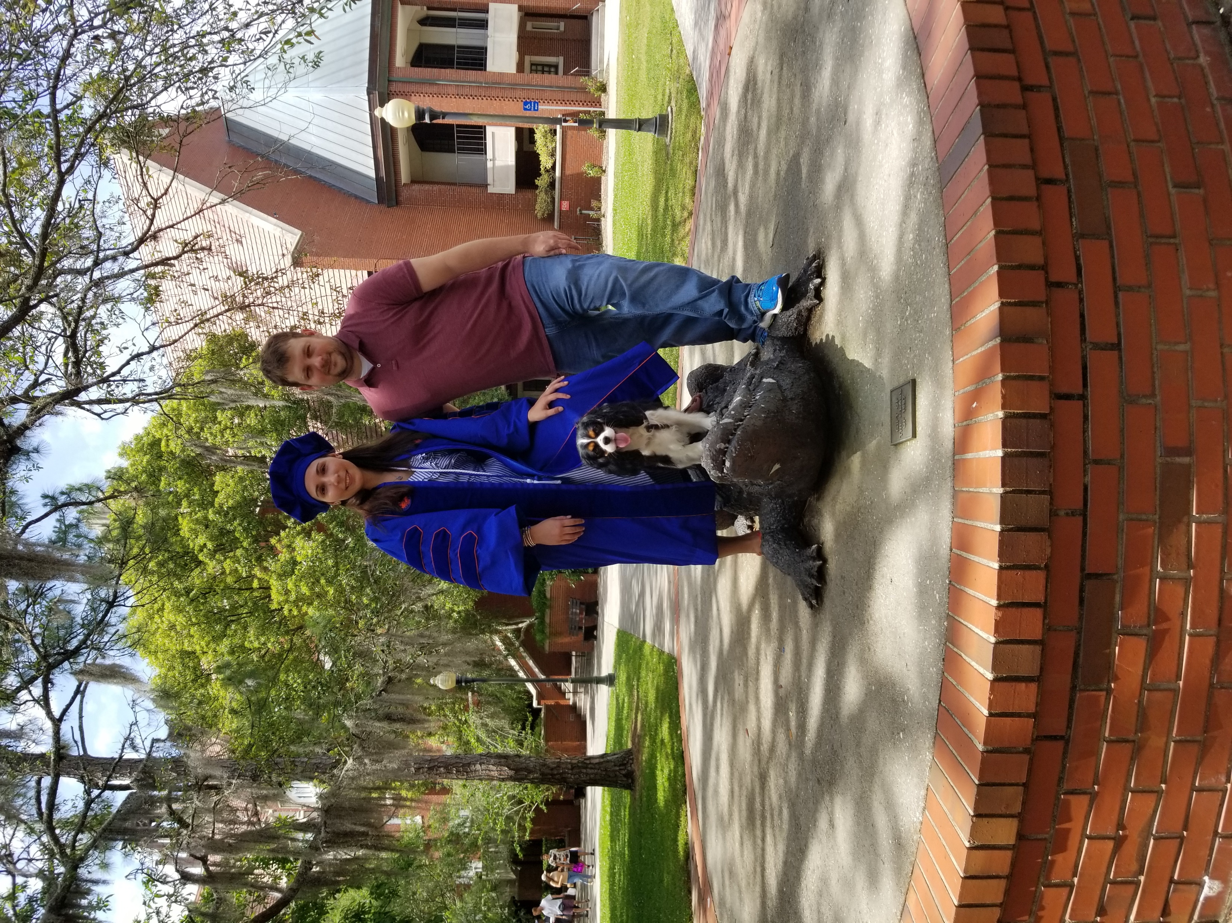

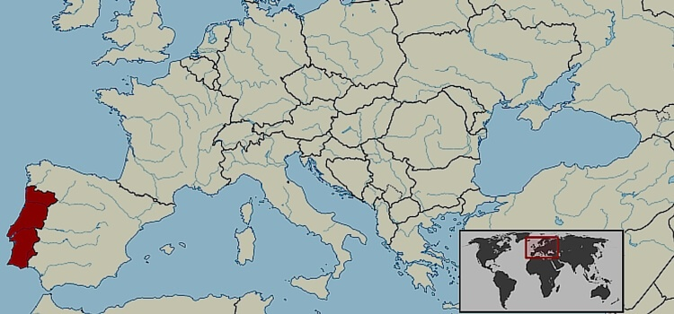
About ME
80-foot wave, Nazare
Dr. Catia Silva (KA-tee-uh SIL-vuh)
Lecturer in Electrical & Computer Engineering Department
Joined UF July 15, 2019
Conducting research in Machine Learning & Signal Processing since 2009
Conduct basic Machine Learning & Pattern Recognition Research
Driven by Application
Porto
Gainesville
Lello bookstore

Slide 4
Matt Cook
2nd year Ph.D. student
Research Assistant in Dr. Alina Zare’s research lab
Develop environmentally adaptive ATR
Previous school/work experience:
University of Missouri (2009 to 2015): B.S. in ECE &M.S. in CE
Naval Surface Warfare Center – Panama City Division (2016 to Present):
Developed Automatic Target Recognition Software for Navy Applications
Research Interests:
Deep Learning
Competency Aware machine learning

Slide 5
Course Website: Canvas & GitHUB
Syllabus (including approximate course schedule) can be found posted on Canvas.
Course Website
Canvas: will be used as a communication channel and to post grades
https://ufl.instructure.com/courses/387418
GitHub: will be used to post all course materials (lectures, assignments & project groups)
https://classroom.github.com/a/PEmVkUrE
Prerequisites
Programing experience
We will be programming in Python

Slide 6
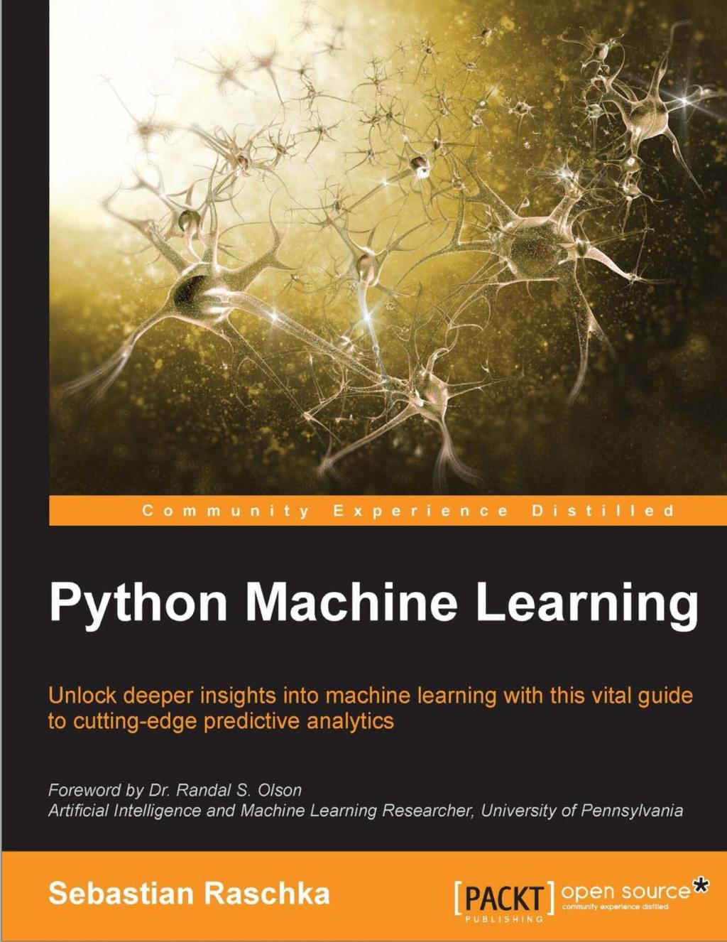
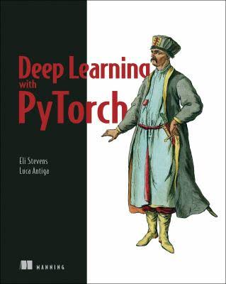





Textbooks & Software - required
Title: Python Machine Learning
Author: Sebastian Raschka
Publisher: Packt Publishing
Year: 2016
Title: Deep Learning with Pytorch
Author: Eli Stevens & Luca Antiga
Publisher: Manning Publications
Year: 2006
Software: Python 3.4.3+
Git
Pytorch
Register to Freely Access the PDF eBook
Manning Publications MEAP Live Book

Slide 7


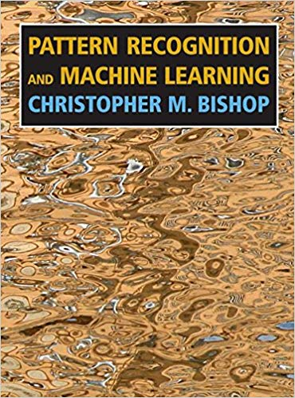
Textbooks - recommended
Title: Pattern Recognition and Machine Learning
Author: Christopher Bishop
Publisher: Springer
Year: 2006
Title: Python Data Science Handbook
Author: Jake VanderPlas
Publisher: O’Reilly Media
Year: 2017
Title: Deep Learning
Author: Ian Goodfellow et al.
Publisher: MIT Press
Year: 2016
Free PDF eBook provided by the author on his webpage
https://jakevdp.github.io/PythonDataScienceHandbook/
http://www.deeplearningbook.org/

Slide 8
Other Materials
A laptop with Python 3.4.3 or later and Anaconda installed will be required
Accept invitation to join GitHub Classroom “MachineLearning-S20” in order to access course materials.
Accept “Welcome to GitHub Classroom” assignment
https://classroom.github.com/a/PEmVkUrE

Slide 9
Grading
Percent | Grade | Grade Points
93.4 - 100 | A | 4.00
90.0 - 93.3 | A- | 3.67
86.7 - 89.9 | B+ | 3.33
83.4 - 86.6 | B | 3.00
80.0 - 83.3 | B- | 2.67
76.7 - 79.9 | C+ | 2.33
73.4 - 76.6 | C | 2.00
70.0 - 73.3 | C- | 1.67
66.7 - 69.9 | D+ | 1.33
63.4 - 66.6 | D | 1.00
60.0 - 63.3 | D- | 0.67
0 - 59.9 | E | 0.00
Grade will be based on:
Homework (30%)
Lab Assignments (20%)
Midterm Exam (20%)
Project (10%)
Final Exam (20%)
Individual assignments will be normalized
Final grades will be curved
During the semester, we will have:
~ 8 Homework
~ 4 Lab Assignments
We will provide assignment solutions

Slide 10
What is Machine Learning?
www.wooclap.com/SNDEMP

Slide 11
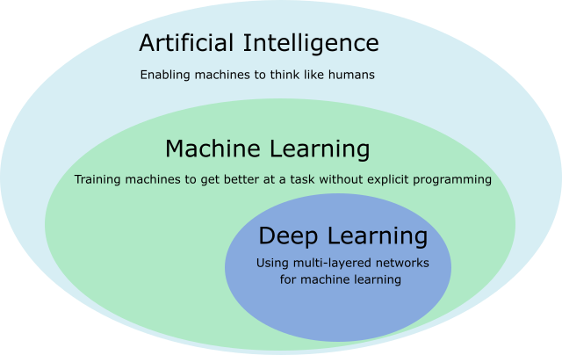
What is Machine Learning?
Artificial Intelligence = Machine Learning ?
Is Machine Learning an Algorithm?
One definition of Machine Learning: study of algorithms that learn from experience/data to make (intelligent) decisions.
e.g. understand cloud patterns in order to design off-grid solar systems
While Artificial Intelligence is the study of intelligent systems that carry out logic, planning, search, probabilistic reasoning, learning from experience, interact with other agents, etc.
e.g. Alexa by Amazon, speech recognition & translation, AlphaGo by Google

Slide 12
Sub-Areas of ML
Supervised Learning
Unsupervised Learning
Neural Networks & Deep Learning
Semi-supervised Learning
Reinforcement Learning
Active Learning
Transfer Learning
Structured Learning
Associative Learning
…

Slide 13


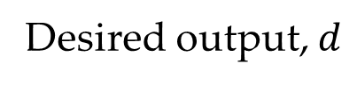
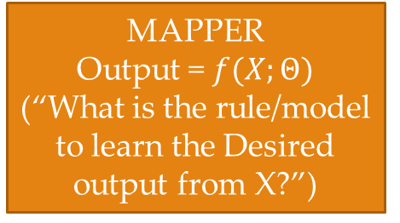
The Machine Learning Process
Desired output, $d$
Output
Observed Data, $X$
MAPPER
Output = $f(X;Θ)$
(“What is the rule/model to learn the Desired output from X?”)
+
Output
Error = Desired - Output
-
+
Cost Function
(“How good was the Output?”)
Example:
Observed data – vital signs, blood tests and electrocardiogram
Desired output – heart attack diagnosis
Learning Algorithm
(“What can we change to make the Output better?”)
SUPERVISED LEARNING

Slide 14
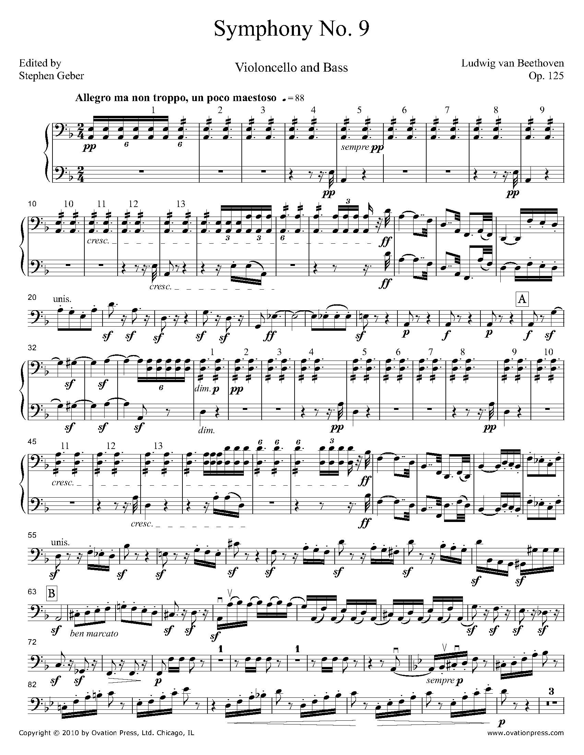
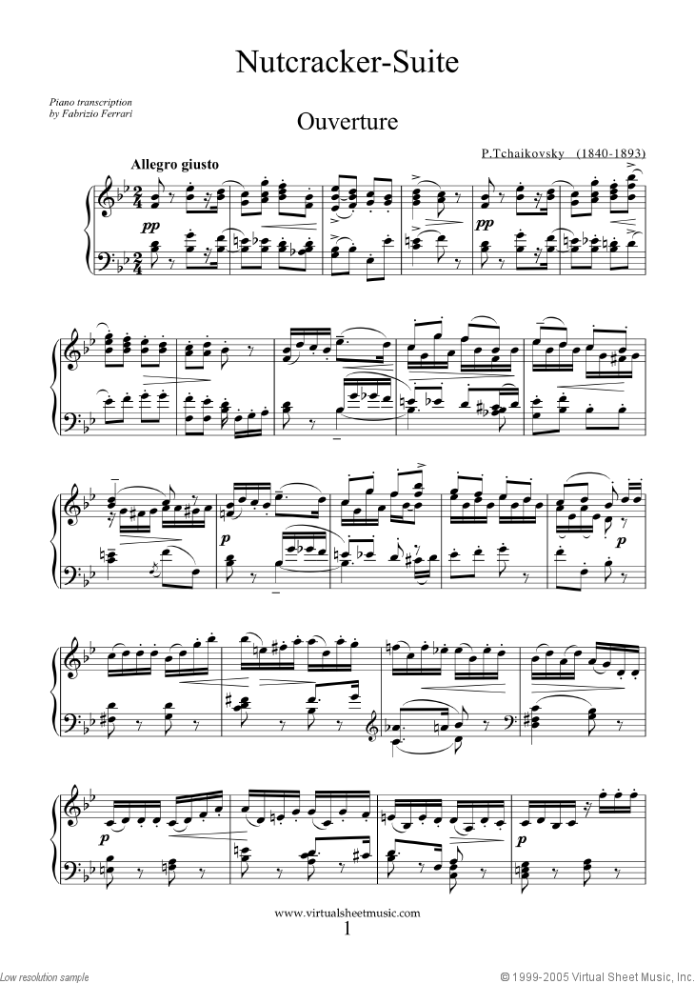
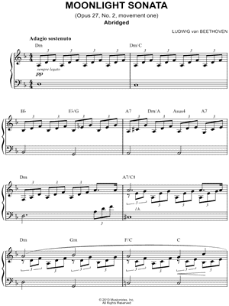
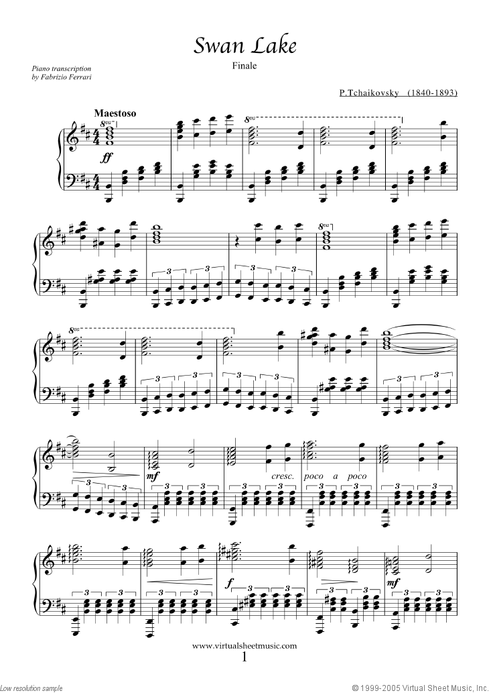
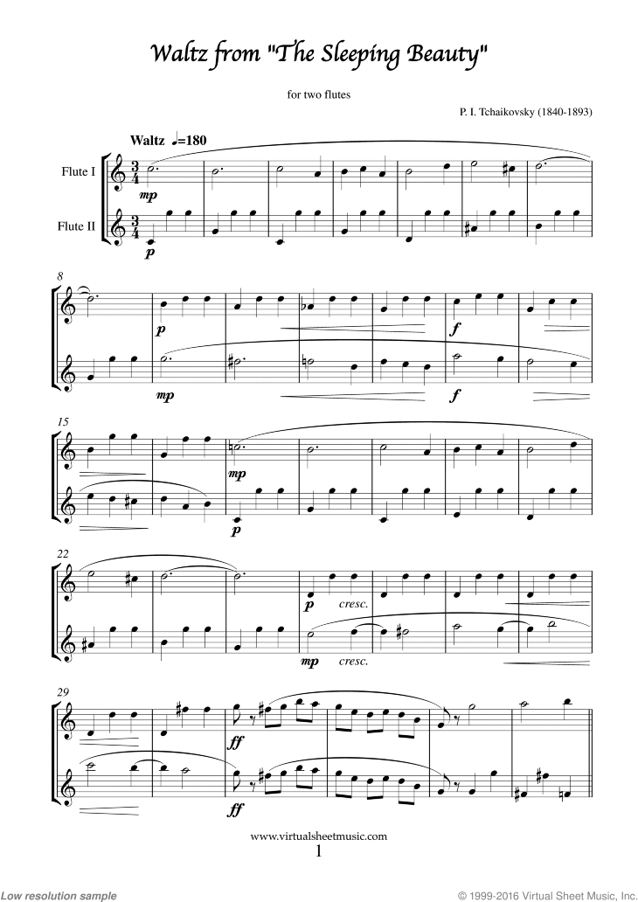
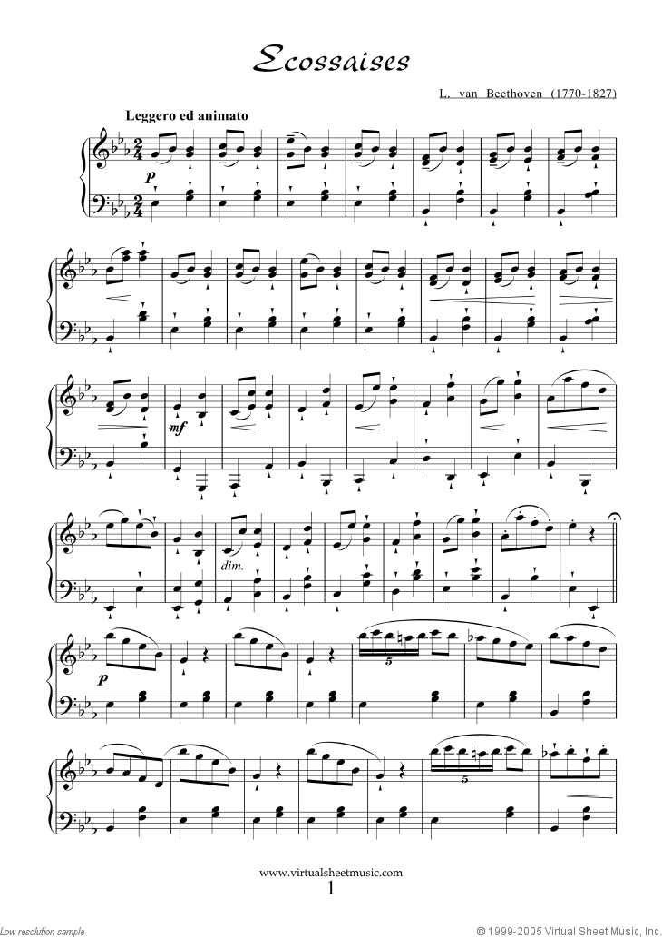

Supervised Learning
CLASSIFICATION
Observed Data
Output
e.g. musical piece
e.g. Musical Composer
Class 0 – Beethoven
Class 1 – Tchaikovsky

Slide 15
Supervised Learning
REGRESSION
Observed Data
Output
e.g. musical piece
e.g. How likely is the user to like the musical piece
0
0.5
1
Unlikely
Likely

Slide 16
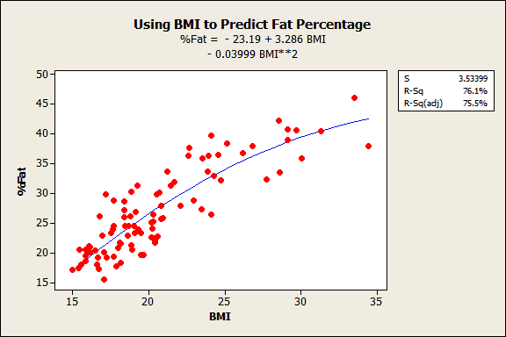
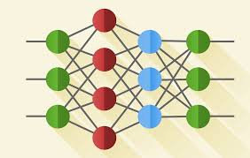
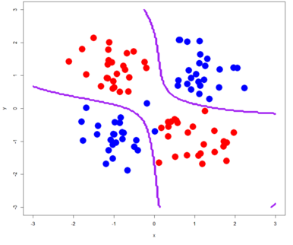

Supervised Learning
Training
Collect Labeled
Training Data
Extract Features
Fit the Model
Select a Model
BPM
Year
Duration
Popularity
Frequency spectrum
Ratio of singing
…

Slide 17
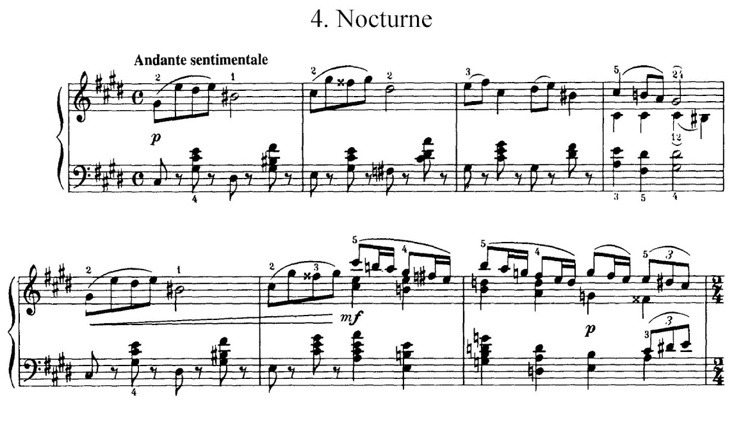
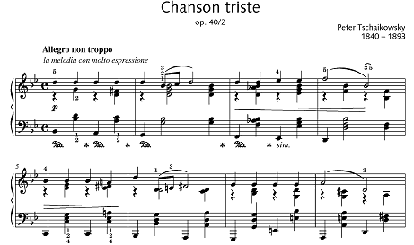

Supervised Learning
Extract (the same) Features
Run it Through Trained Model
Testing
Given Unlabeled Test Data
BPM
Year
Duration
Popularity
Frequency spectrum
Ratio of singing
…

Slide 18
What are the challenges?
How do you know if you have representative training data?
How do you know if you extracted good features?
How do you know if you selected the right model?
How do you know if you trained the model well?

Slide 19
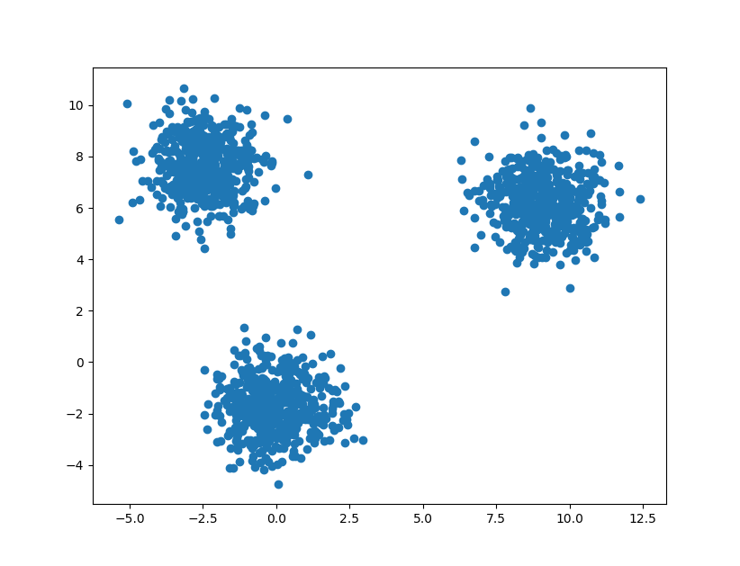
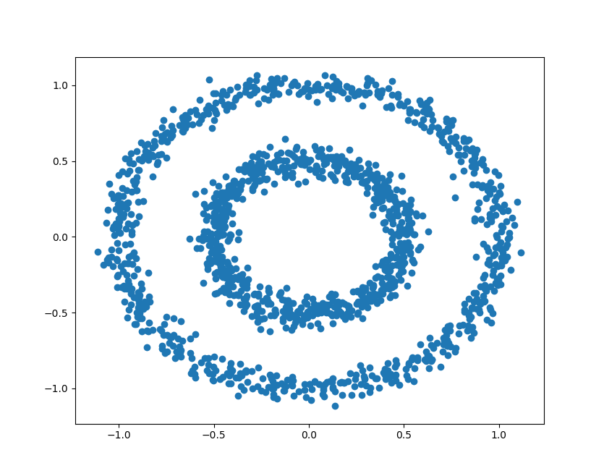


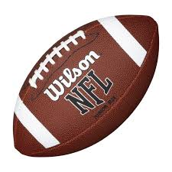






Unsupervised Learning
Learning structure in the data without any labels
Example Case 1
Example Case 2
Example Case 3
How did you determine the numbers of cluster per example case?

Slide 20
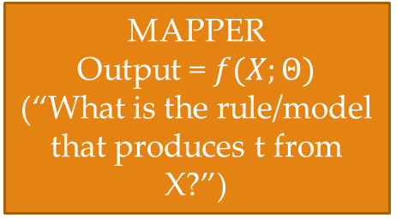
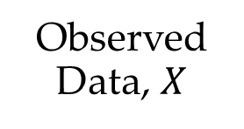

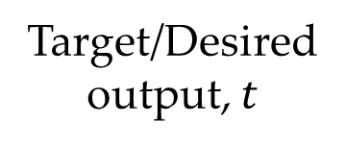
Target/Desiredoutput, $t$
Output
MAPPER
Output = $f(X;Θ)$
(“What is the rule/model that produces t from X?”)
+
Output
Error = Desired - Output
Features of $X$
-
+
Objective Function
(“How good is the Output?”)
Observed Data, $X$
Learning Algorithm
(“What can we change to make the Output better?”)
SUPERVISED LEARNING
Path 1: Observed Data – Extract Features – Design Model – Fit the Model
Path 2: Observed Data – Design Model – Fit the Model

